Slide 1
Real Time Trend & Failure Analysis using Test Trend Analyzer (TTA)
Anand Bagmar
Aasawaree Deshmukh
Notes:
> Explain the business case of why you need something beyond the scope of CI to understand the real-time health and trend of your organisation's product portfolio
> How can TTA bridge that gap?
> What is the value proposition for TTA
> Demo of TTA features
> Next set of potential features
> How can you help?

Slide 2

Reality in Organizations
Globalization
Cost
Talent
24 x 7
Mergers & Acquisitions
Team size
Notes:
Manish
Distributed teams are fact of life.Some of the reasons why distributed team exist
Globalization - Organizations trying to expand into emerging markets.Also there is a need for localization for the
market
There is an increasing pressure to increase the value delivered for every dollor spent
For some teams 24*7 testing is essential to help rapid releases and provide rapid feedback from test.
Rapid Globalization is happening as a result of acquisitions and Mergers for companies to remain competitive
Team size - Larger projects mean larger team.It may not be possible to locate everyone in same physical space

Slide 3
Test Director / Business Head
Product 1
Product 2
Product 3
Product 4

Slide 4
Test Manager / Product Owner
Product 1
Product 2
Product 3
Product 4

Slide 5
Test Engineer/ Team Member
Product 1
Product 2
Product 3
Product 4

Slide 6
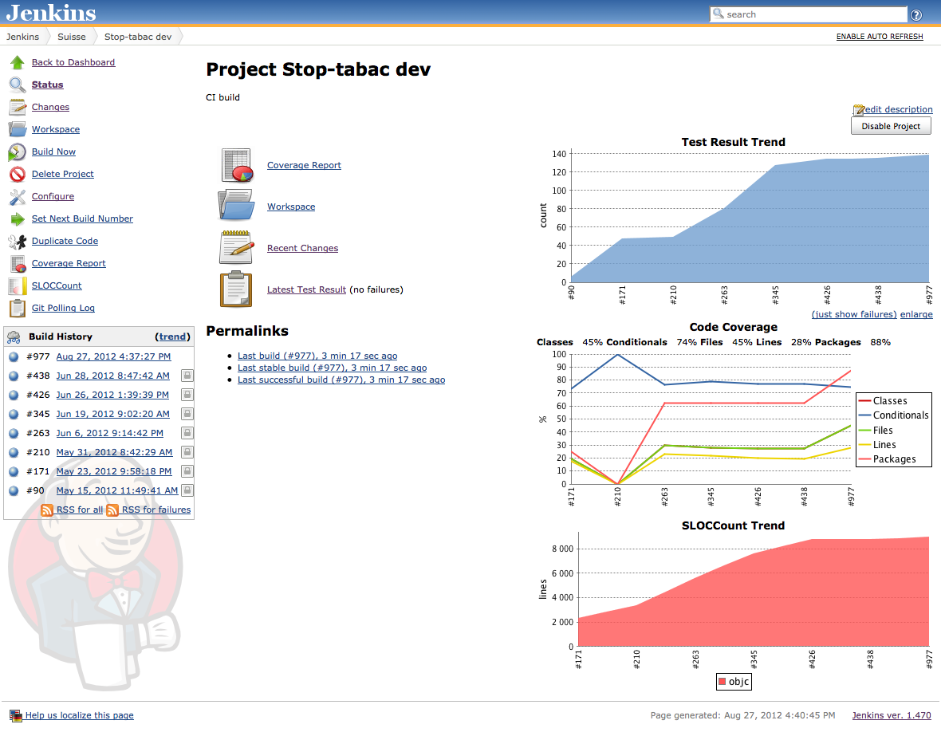

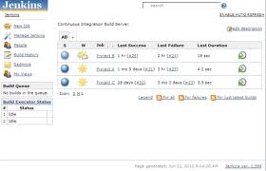

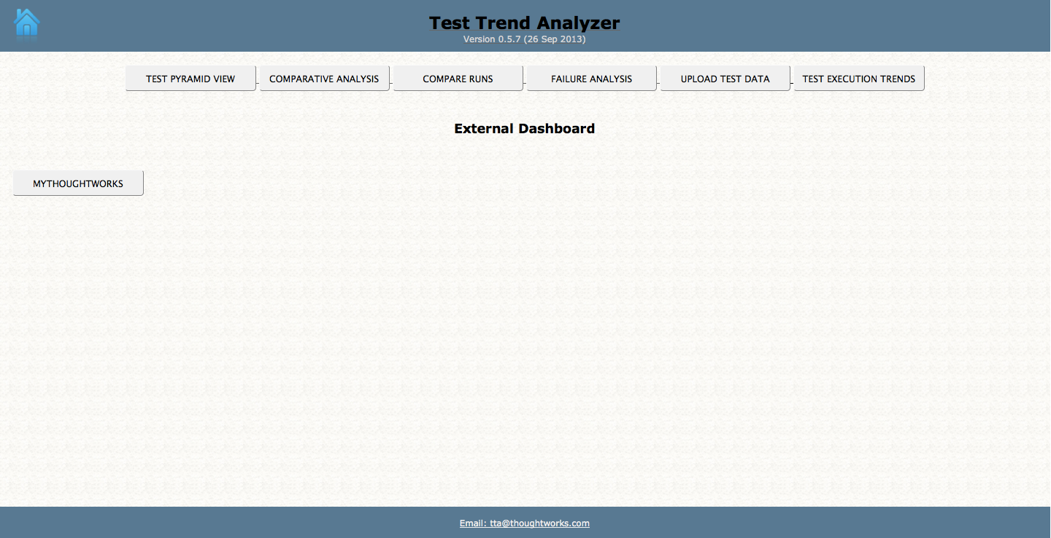

Slide 7
TTA – Test Trend Analyzer - Vision
A single point, visual solution to gauge the health of your product portfolio using Test Automation results by means of –
Comparative views
Trends analysis
Failure analysis
and providing
Drill-down reports
Customizable reports
So that
Different stakeholders can get single click view of the health status and potential issues
A project team can decide if automation is useful or not.
automated data collation and trending to avoid manual data aggregation and interpretation
With the stakeholders being
Developers
QA
QA Leads / Manager / Directors
Tech-Ops

Slide 8
Collect Test Run data in TTA
Manual Upload
Automatic Upload

Slide 9
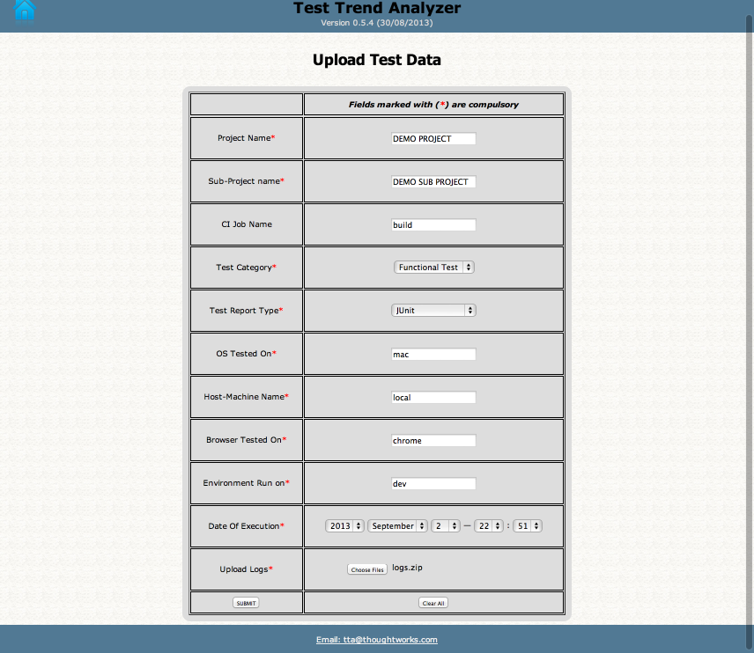
Manual Upload

Slide 10
Decoupled from CI / Tools / Technologies
Diagram

Slide 11
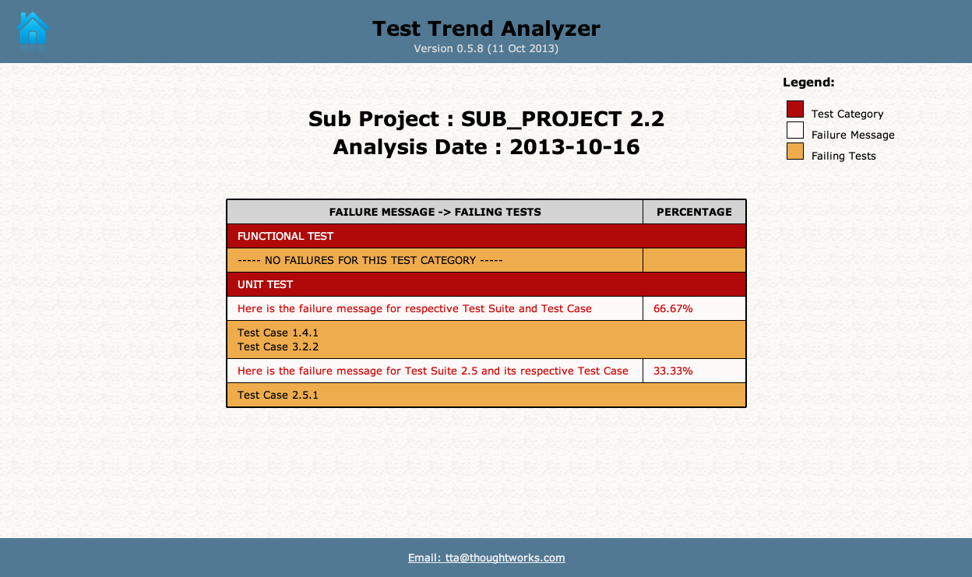
Failure Analysis

Slide 12
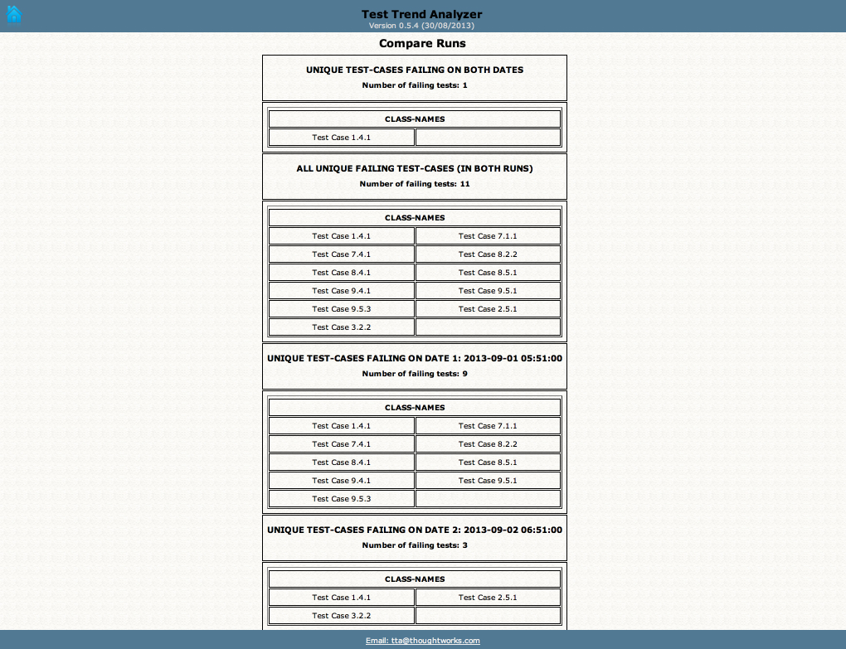
Compare Runs

Slide 13
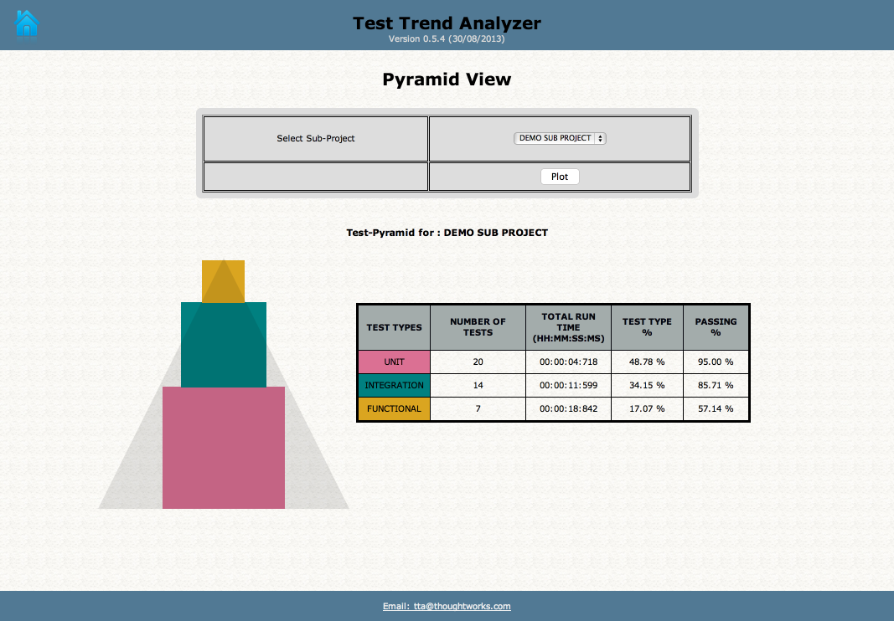
Test Pyramid View

Slide 14
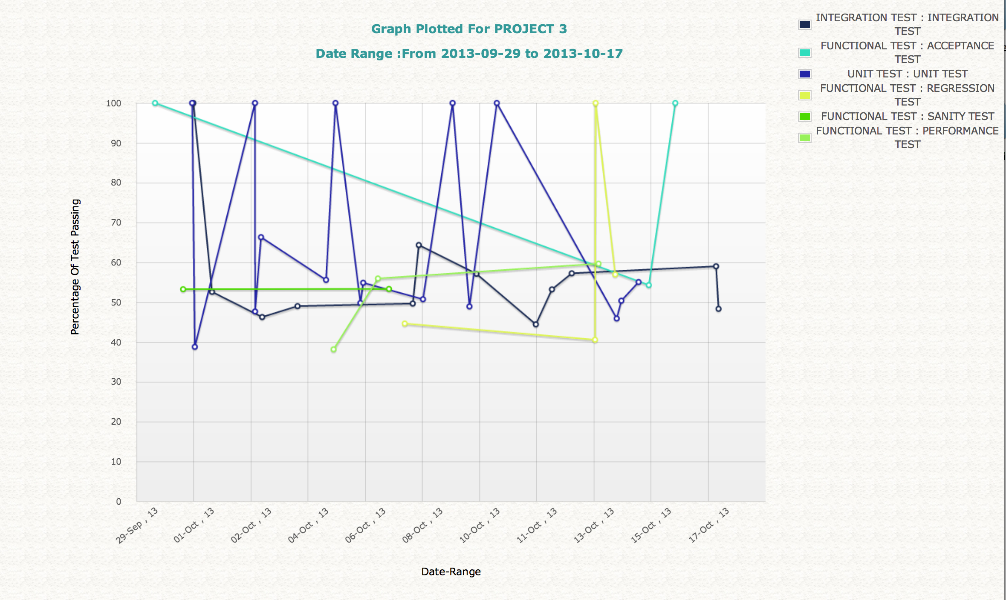
Comparative Analysis

Slide 15
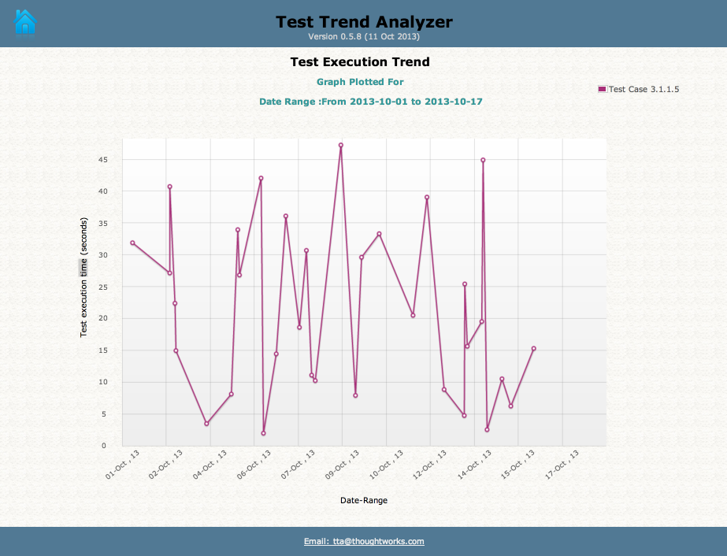
Test Execution Trends

Slide 16
Test Dashboard
Test execution
Automated test run
Manual (to-be-automated) regression test runs
Manual test runs (story-level)
Defect status
Iteration status

Slide 17
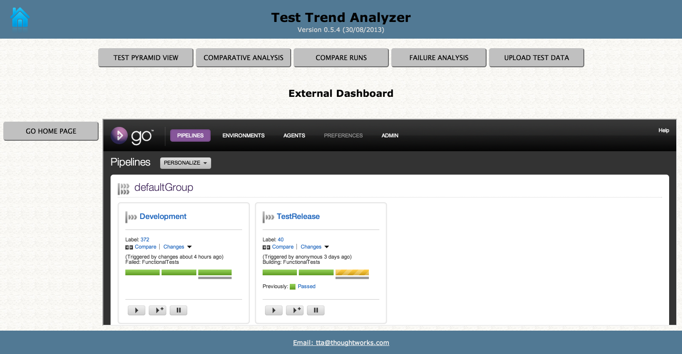
Test Dashboard

Slide 18
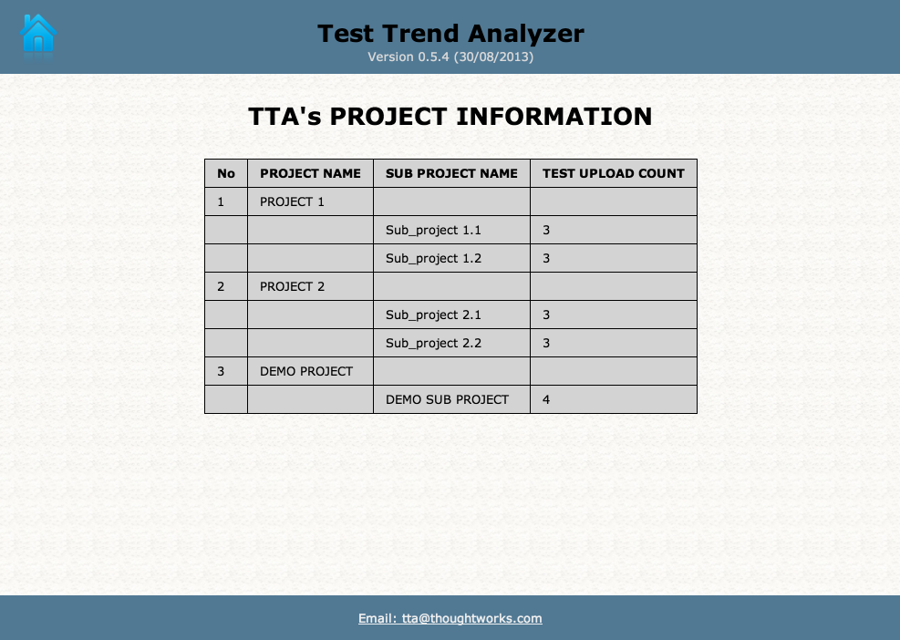
Stats

Slide 19
For Different Sub – Projects

Slide 20
Test Status for a Single Project

Slide 21
For Tech-Ops / IT

Slide 22
How to use TTA
Copyright 2013 ThoughtWorks, Inc.
Distributed under the Apache 2.0 License
Available on github at:
https://github.com/anandbagmar/tta
Instructions available on github wiki at:
https://github.com/anandbagmar/tta/wiki

Slide 23
Questions
Contact:
Send an email to tta@thoughtworks.com
@BagmarAnand
Copyright 2013 ThoughtWorks, Inc.
Apache 2.0 License

